Slide 1

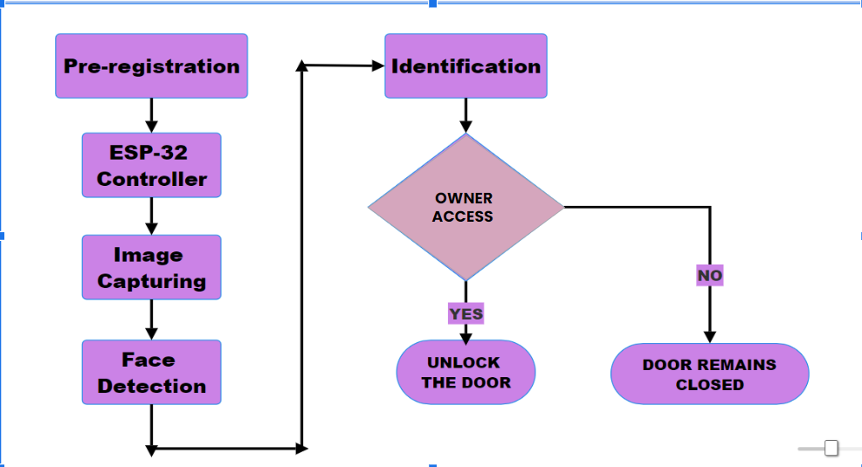
Advanced Home Security :Face recognition integration with ESP32-CAM.
Context:
Advanced home security, integrating face recognition technology with the ESP32-CAM microcontroller module offers a versatile and cost-effective solution for enhancing the security of residential premises. This integration involves leveraging the ESP32-CAM's capabilities for capturing images and processing them locally to perform real-time facial recognition.
Building a advanced home security solution the leverages cutting edge technologies like facial recognition integrated with ESP32-CAM microcontroller
Flow Chart
Problem Statement:
Deliverables :
Privacy and security measures
Facial recognition algorithm implementation .
Working of ESP32-CAM
Training/ Pre requisites:
Understanding C/C++,Microcontroller programming .
Knowledge about processing and computer vision
Drivable
\
Timeline
Kick Off < 1st Month >
Milestone 1 < 2nd Month >
Milestone 2 < 3rd Month >
Starter Reference Material:
Madupu, Pranav Kumar, and B. Karthikeyan. "Automatic Service Request System for Security in Smart Home Using IoT." 2023
Second International Conference on Electronics, Communication and Aerospace Technology (ICECA). IEEE,2021
M. Edmonds and N. Chandler, How Smart Homes Work. Accessed: Aug. 2019.
Research and training of the model according to the requirements of security system .
Final implementation and testing all the applied concepts on ESP32-CAM .
Understanding various concepts ,and research on facial recognition integrated with ESP32-CAM microcontroller.

